Slide 1

COPD Web app
Tomás Santos nº47050
João Martins nº45644

Slide 2
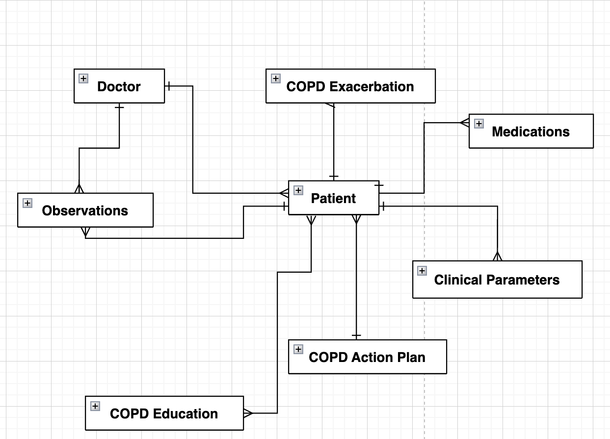
Entities

Slide 3
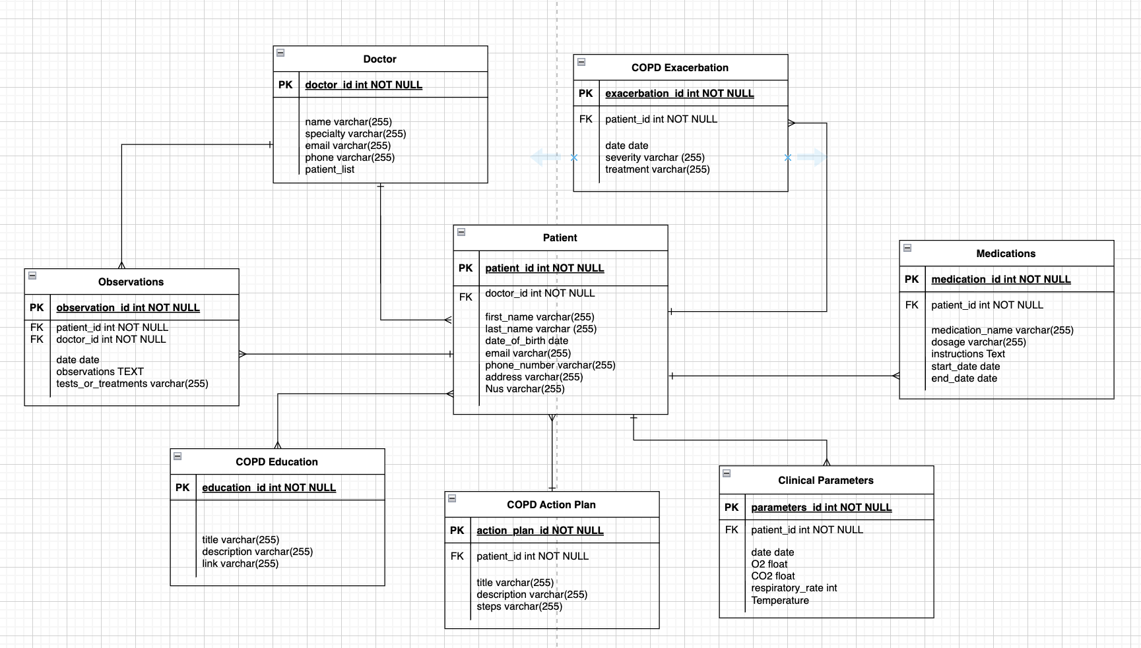
Database Structure

Slide 4
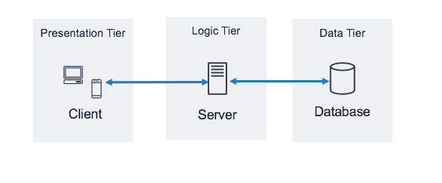
System architecture

Slide 5
Functional Requirements
1. Recording and storage of patient data and useful parameter measurements.
2. Interoperability -
1. Data stored in an FHIR format and shared with the patient's healthcare system or a specific healthcare provider.
2. Access to information about medications, dosages and medication relaxation.
3. Gamification
1. Educational materials and resources about your condition.
2. Chat with an "artificial health professional".
3. Promotion of physical exercise through tests such as the 6-minute walk test (6MWT) and the 1-minute sit-to-stand test (1MSTS), even taking the opportunity to collect data and post-analysis.

Slide 6
Non-Functional Requirements
The portal/app should be secure to prevent unauthorized access to patient information. Patient data is sensitive information.
• GDPR/HIPAA compliance (patient privacy)
• Accessibility: designed to be accessible to people with disabilities
• User interface design (easy and intuitive to navigate and use)
• Hosting and maintenance: where will be hosted and how it will be maintained
• Compatibility: designed to work on laptop, PC, mobile device

